Slide 1
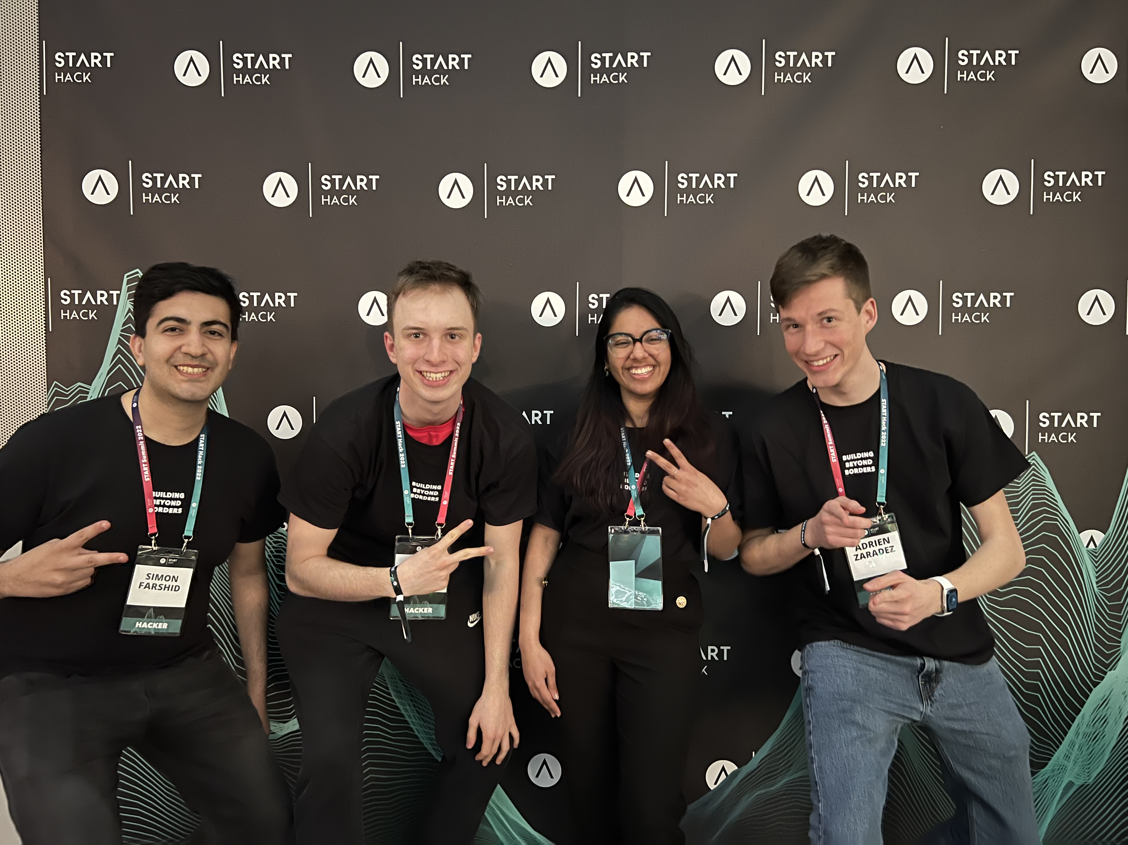
POWER TO THE PLAYERS

Slide 2

Problem
It’s hard to send social cues over chat
which leads to widespread cyber bullying and harassment.
Notes:
ADRIAN AFTER FIXING HIS PPT: TO BE DELEGATED

Slide 3
Solution?

Slide 4
ChatGuard
A chat framework for more empathetic interactions in the digital world.

Slide 5
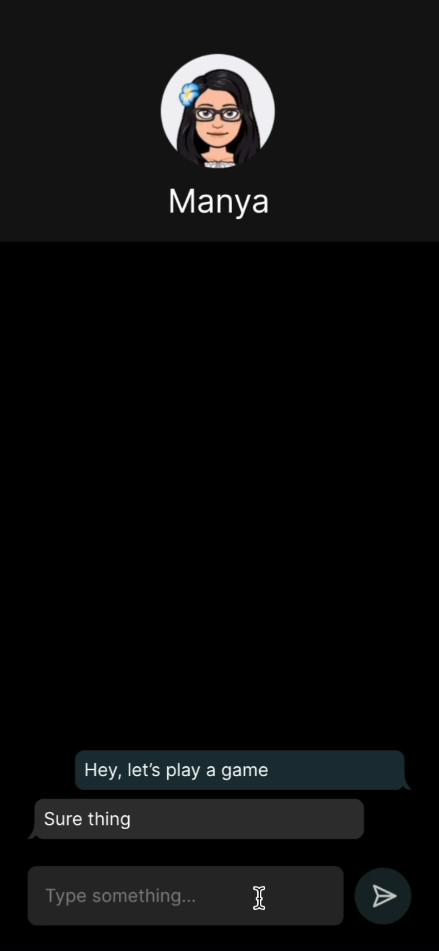
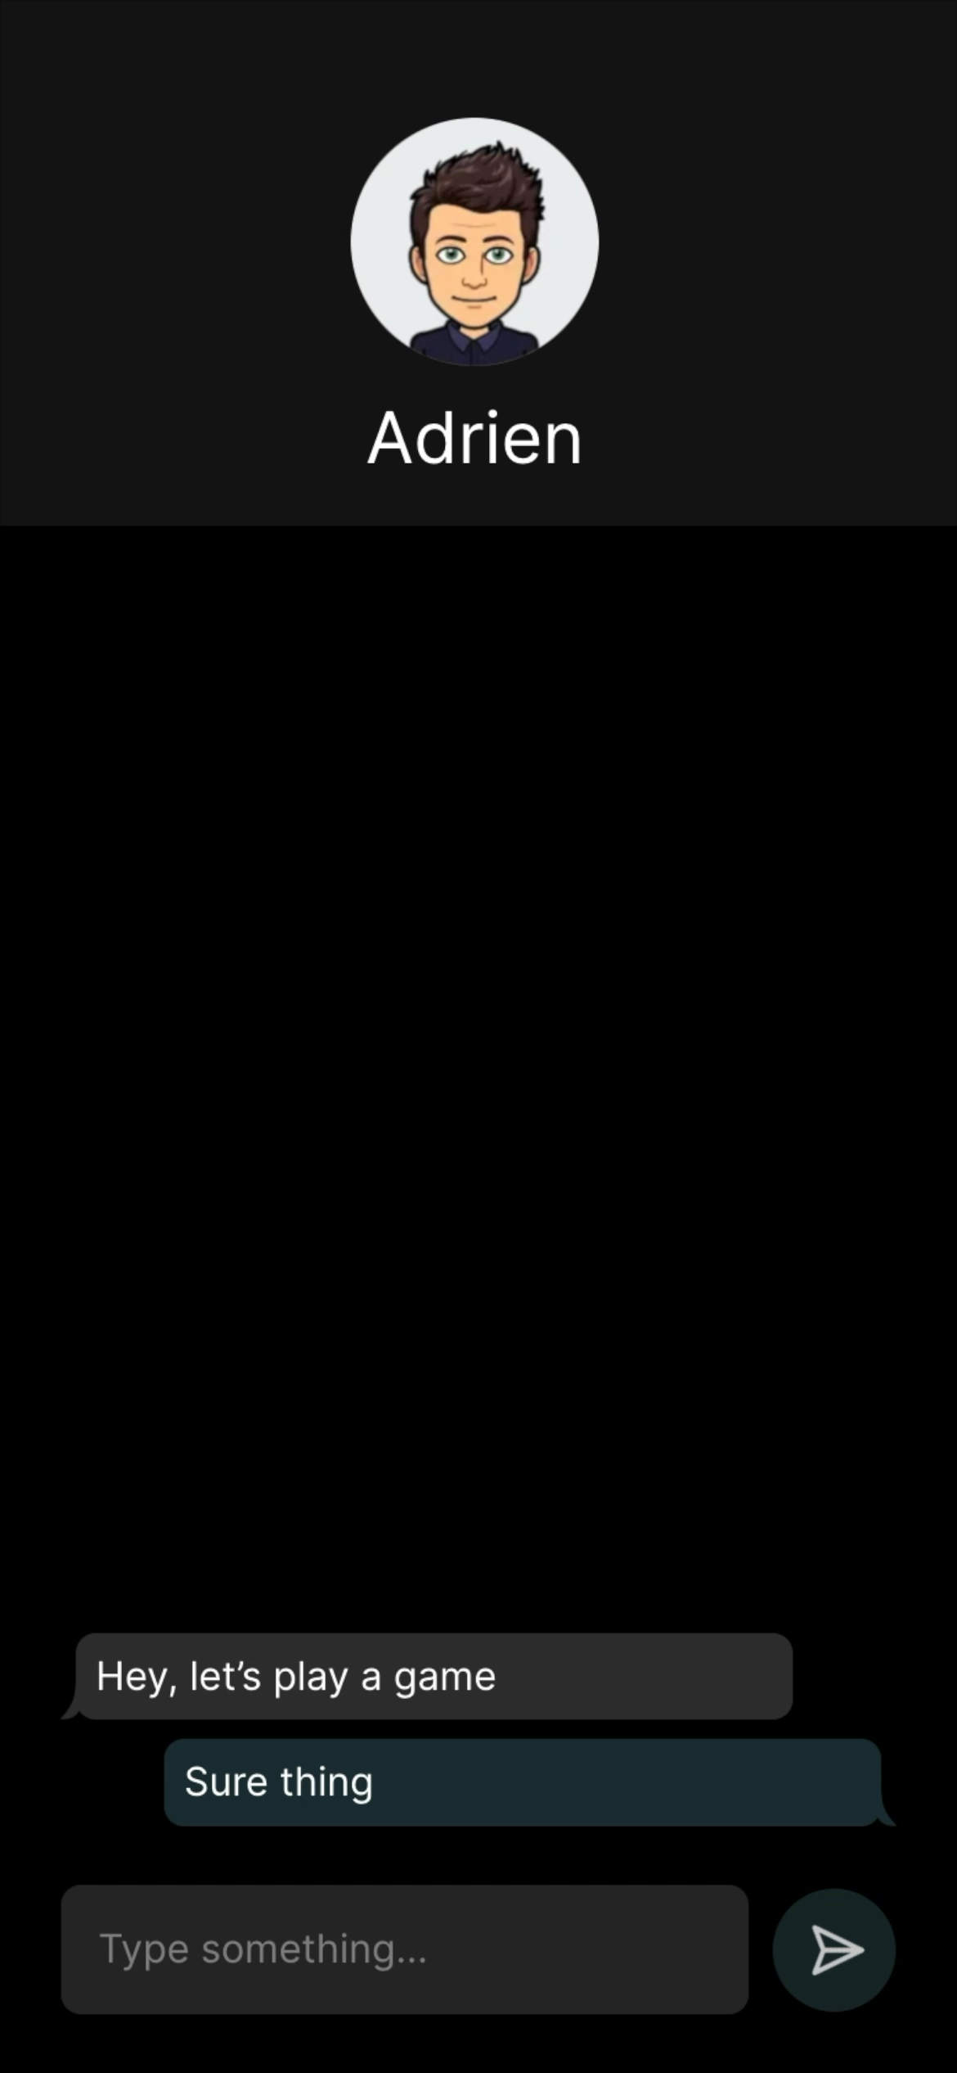
Adrien’s Phone
Manya’s Phone

Slide 6
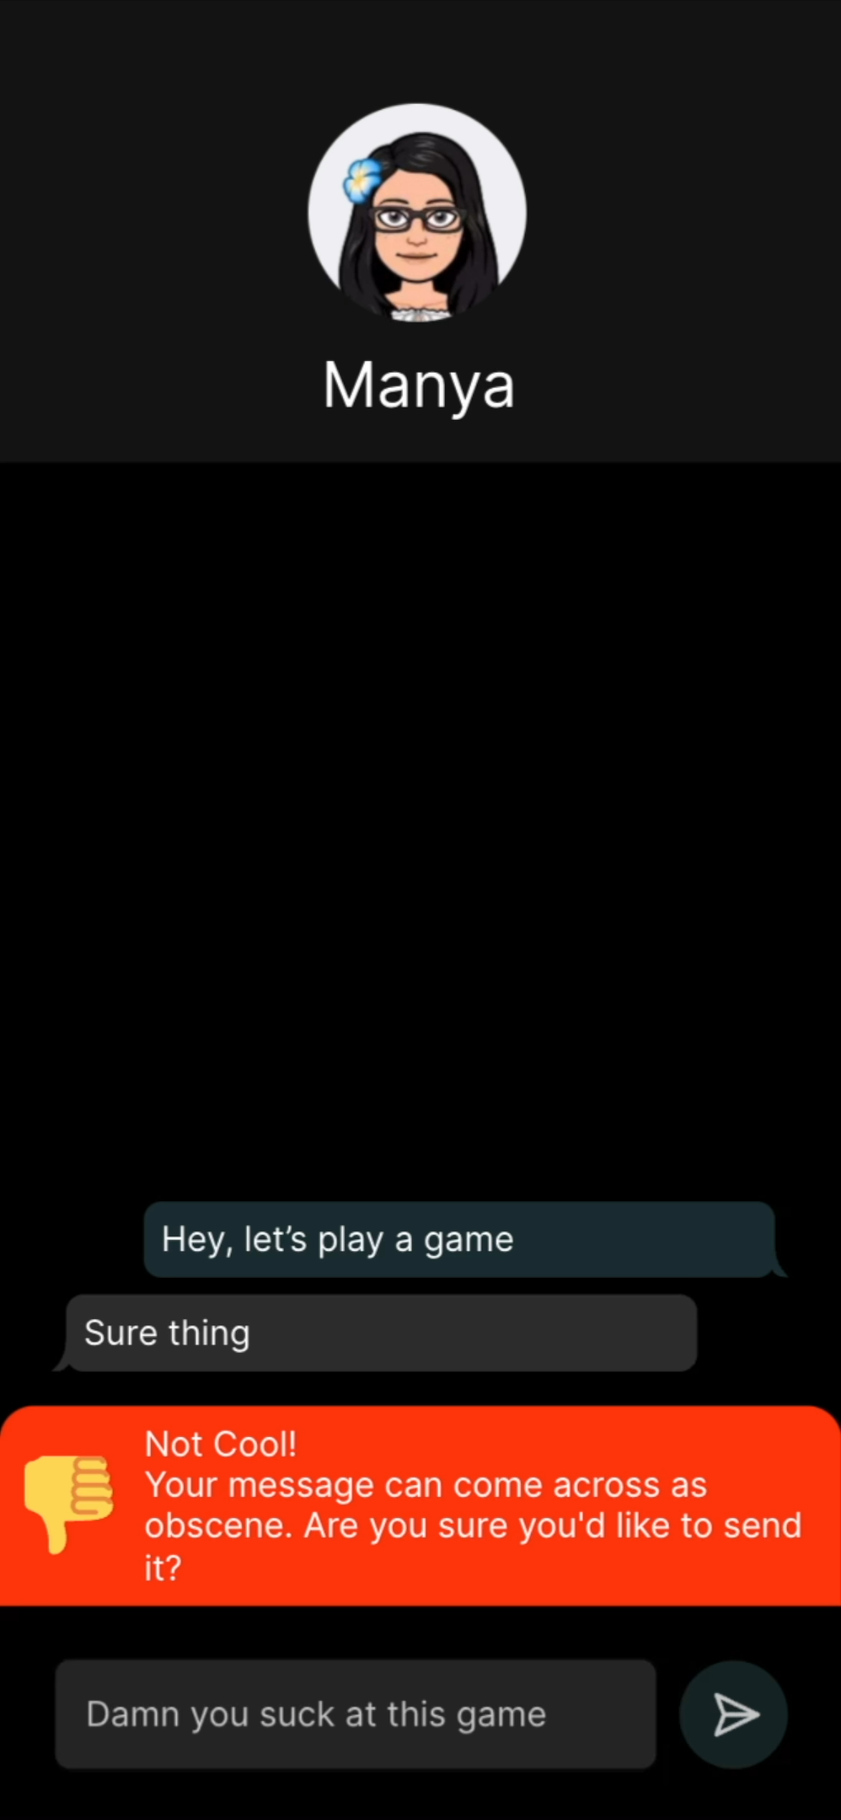

Adrien’s Phone
Manya’s Phone

Slide 7
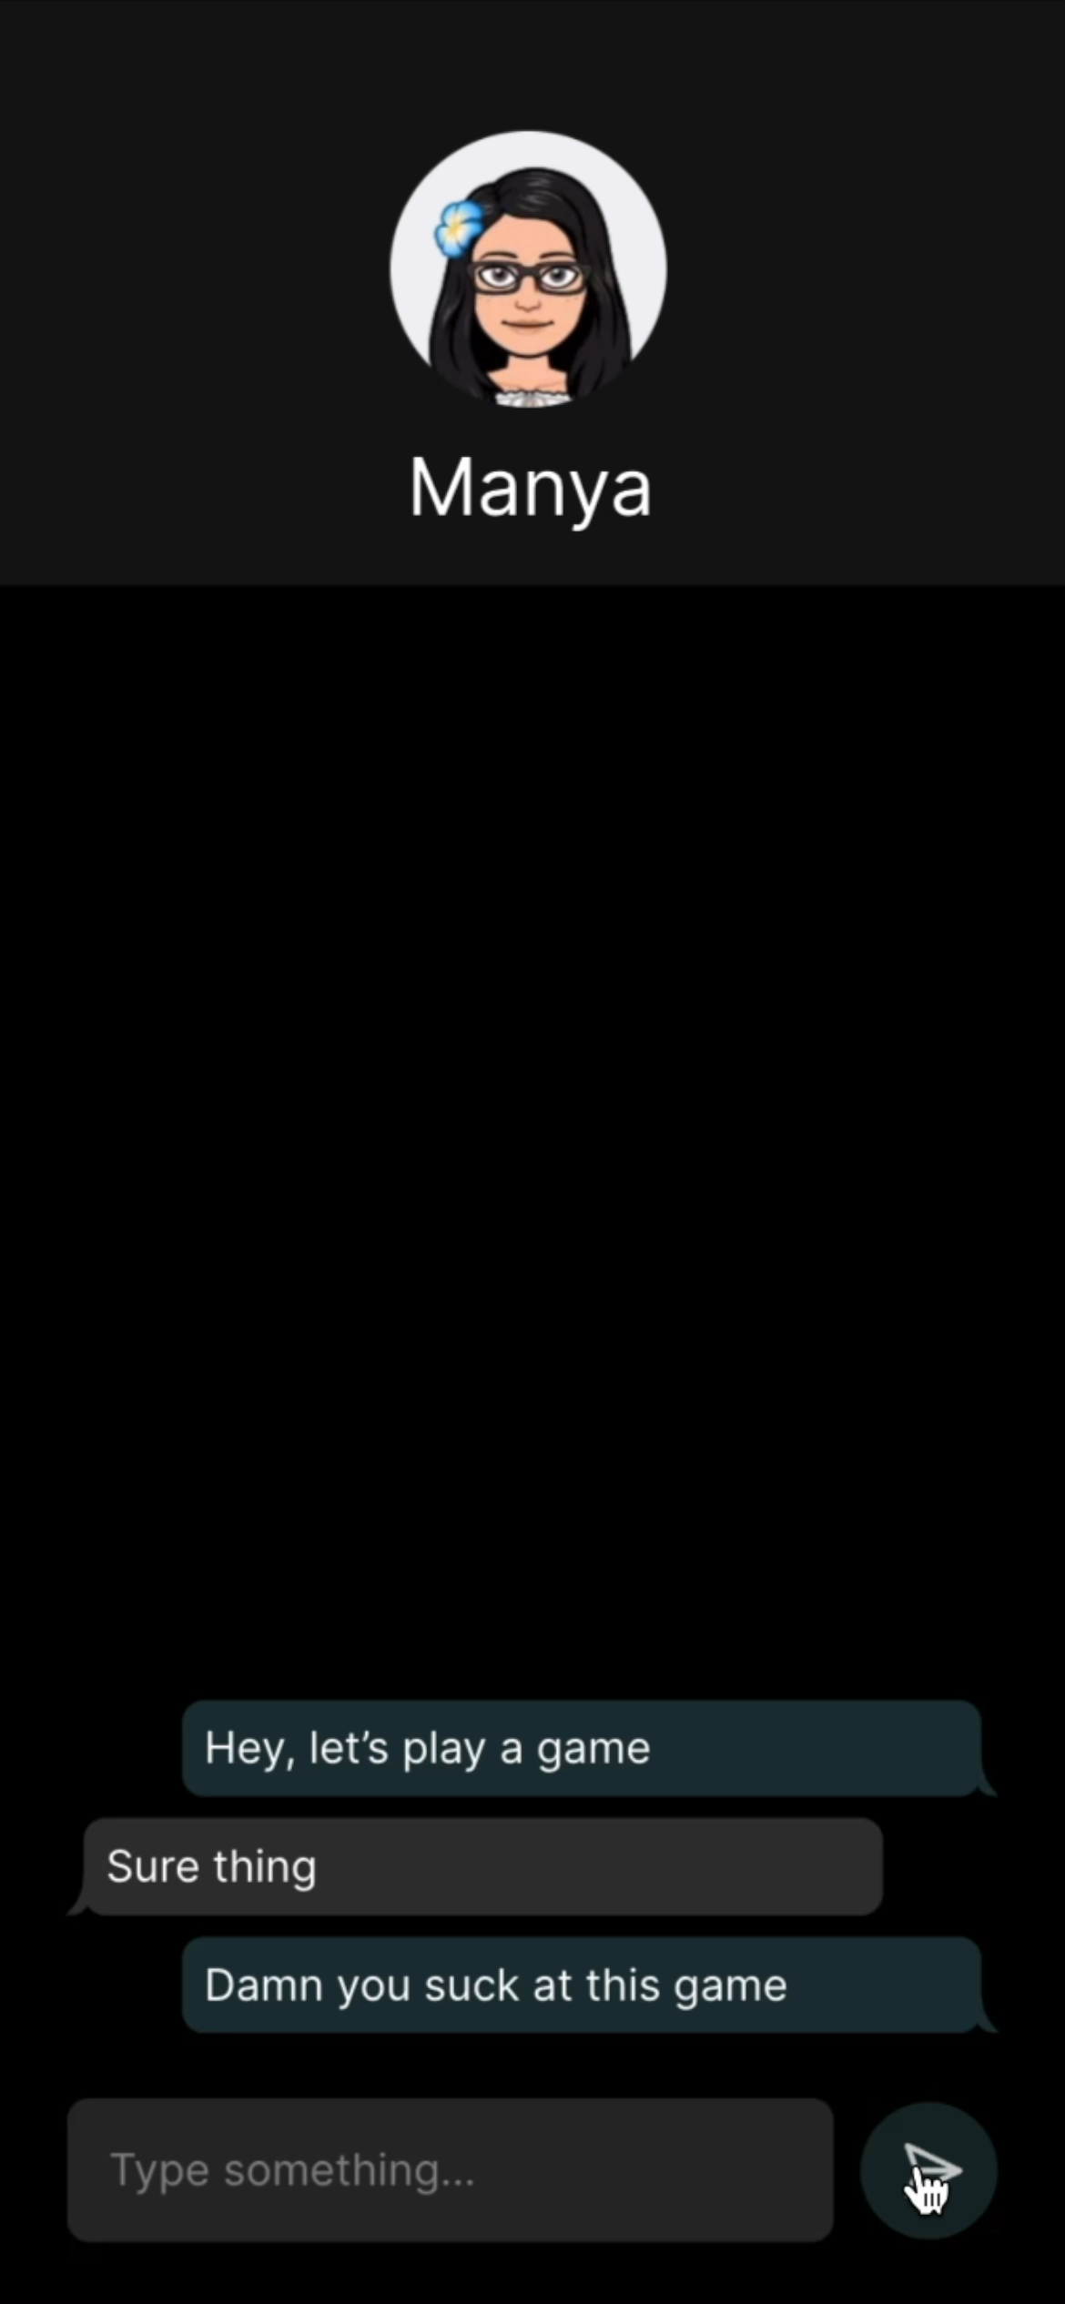
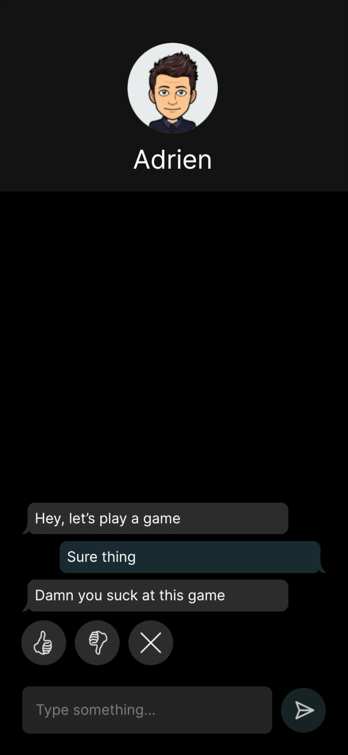
Adrien’s Phone
Manya’s Phone

Slide 8
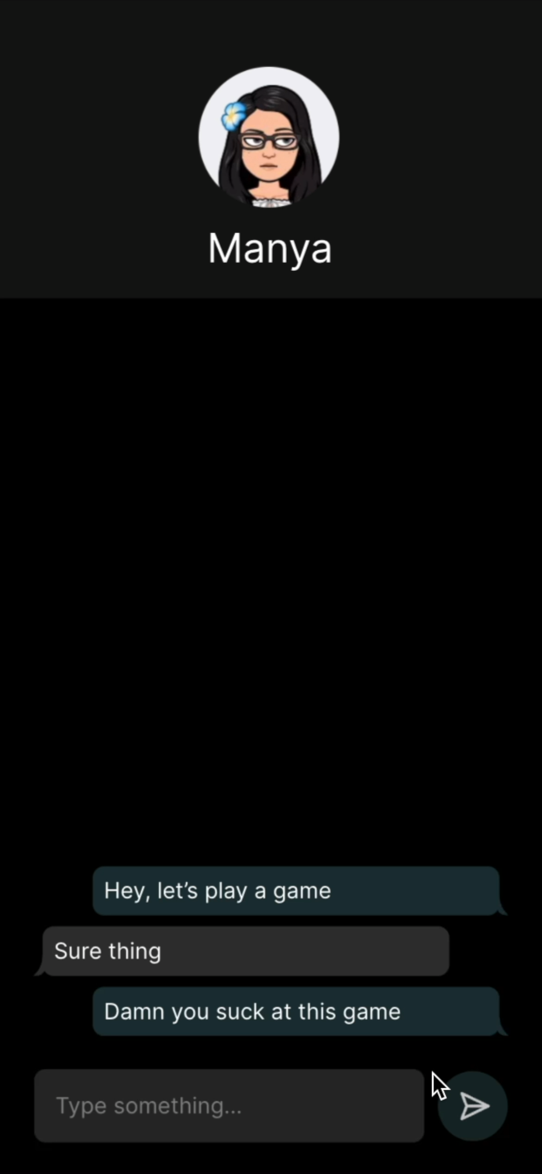
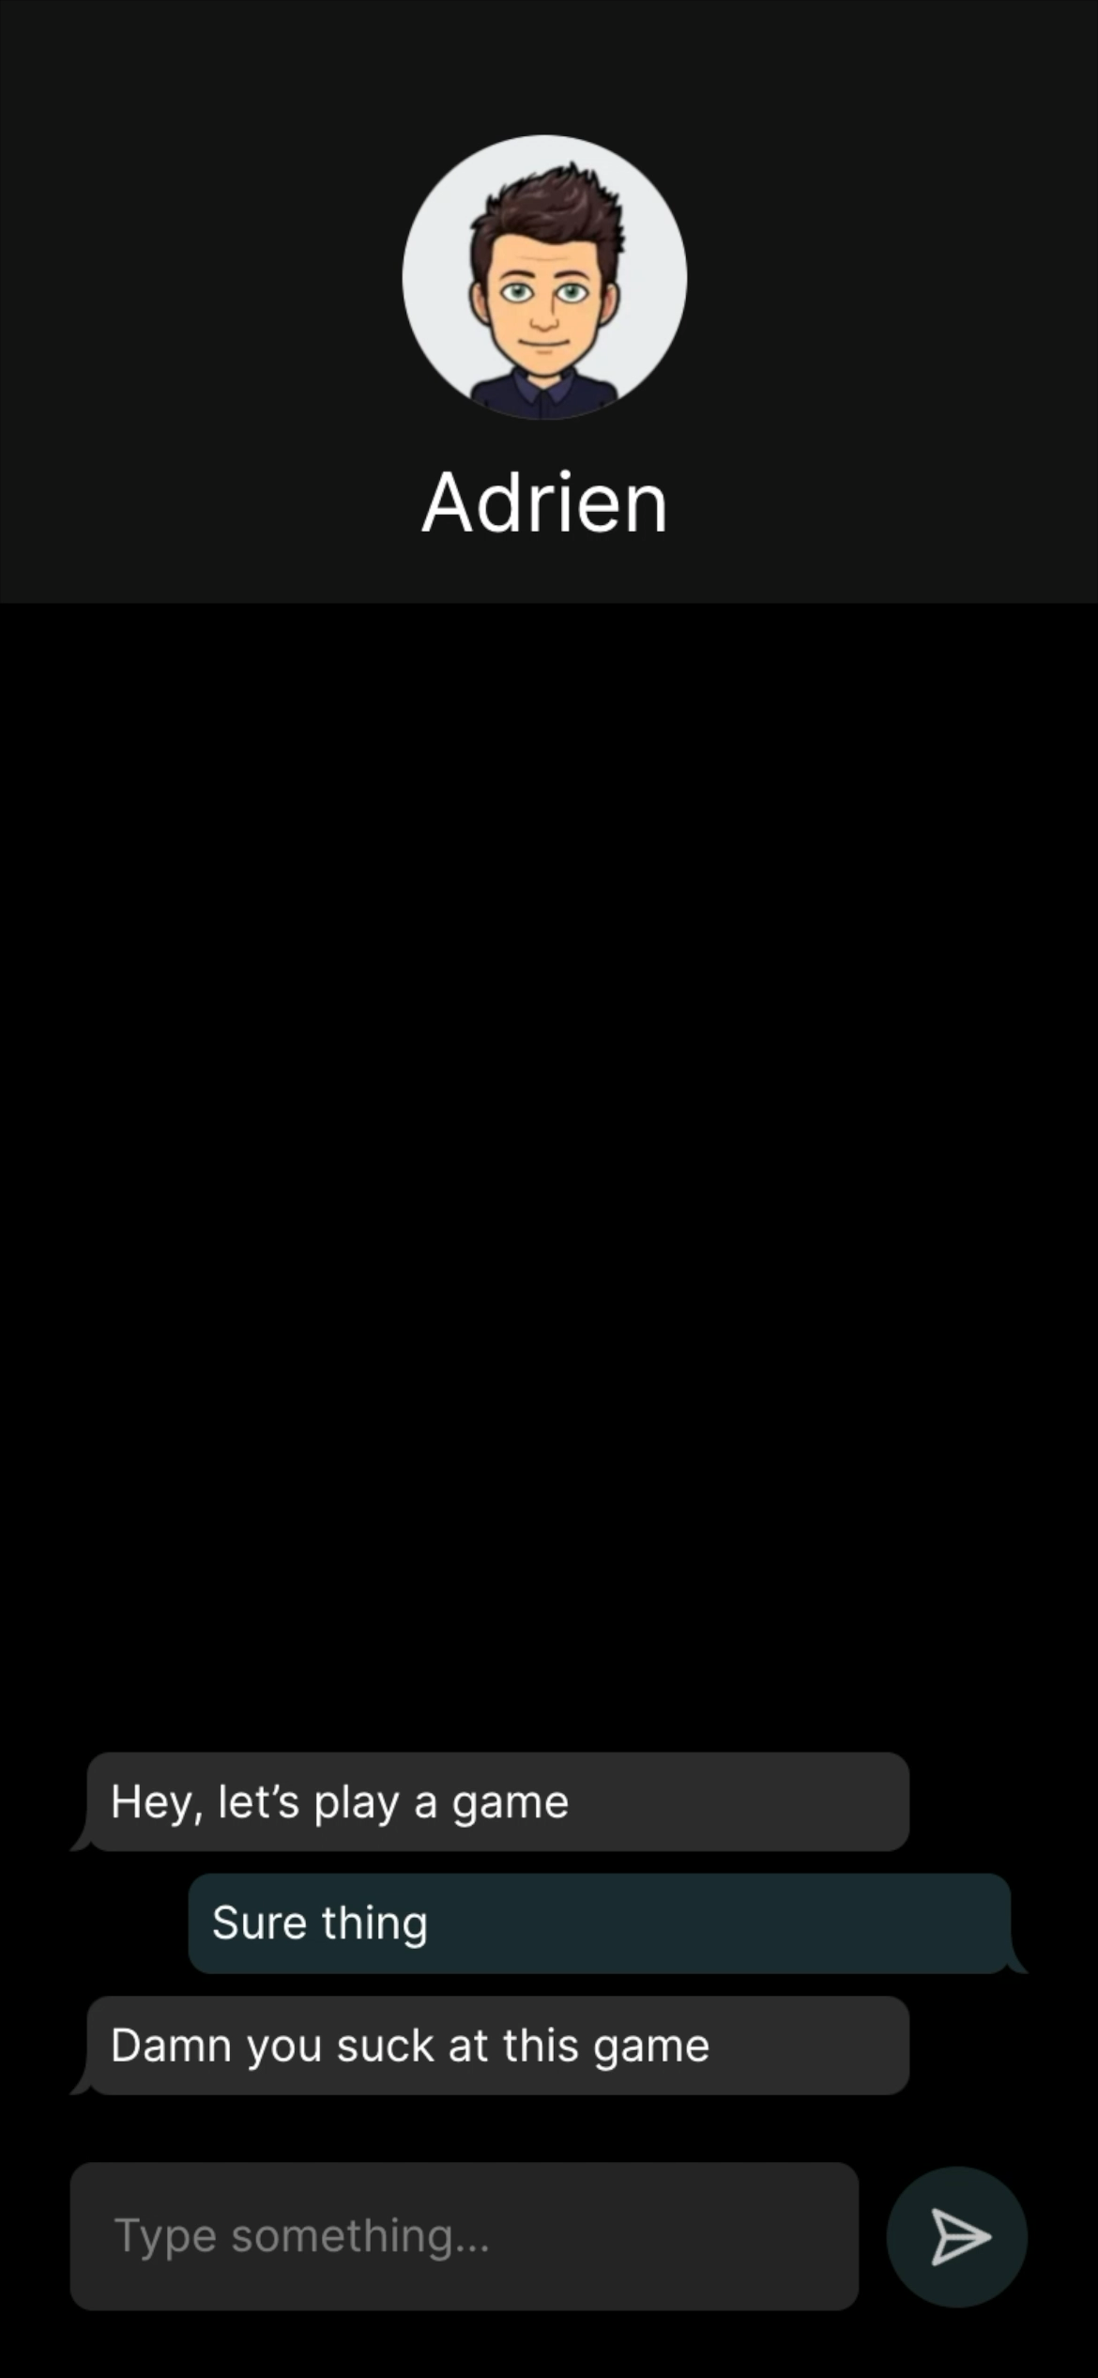
Adrien’s Phone
Manya’s Phone

Slide 9
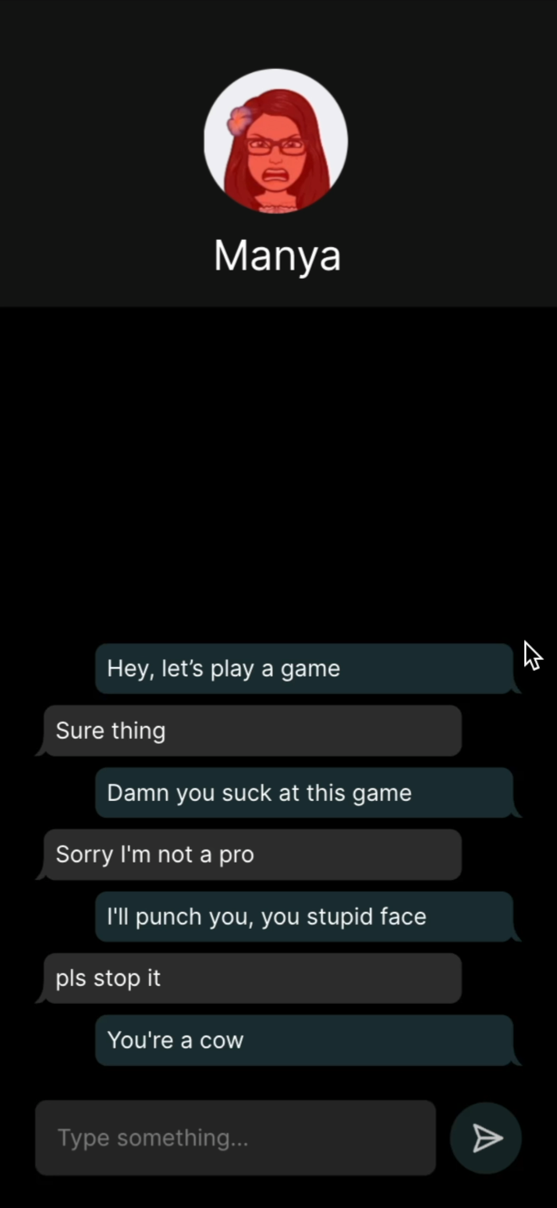
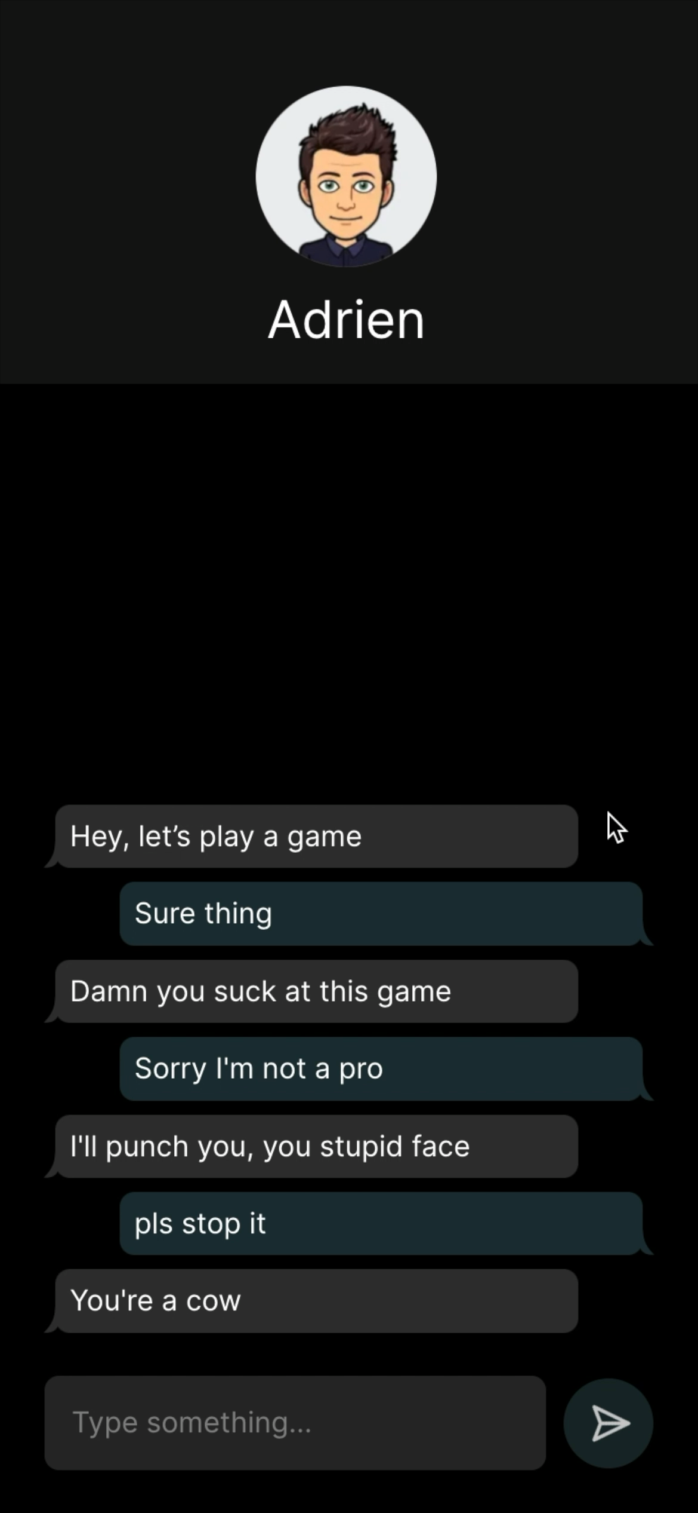
Adrien’s Phone
Manya’s Phone

Slide 10







Group Chat Support
Positive Reinforcement for Improved Behavior
Reduce Cyber Bullying & Harrassment
Continuous Machine Learning
Punishment
for bad behavior
Web API
Player Education
SDK for Integration in Games
Analysis of
In-Game Performance
on Behavior
Context-aware
player support
Localization Support

Slide 11



In-Game Cues
Loss or Victory of players.
Correlation between competitiveness and toxicity.
Game interactions between same team players.

Slide 12
Business Model
SaaS API for Chat-Enabled Games
TAM: 120 milllion CHF Revenue Potential
Based on 1 billion MAU in chat-enabled games times 0.01 CHF per MAU per month.

Slide 13
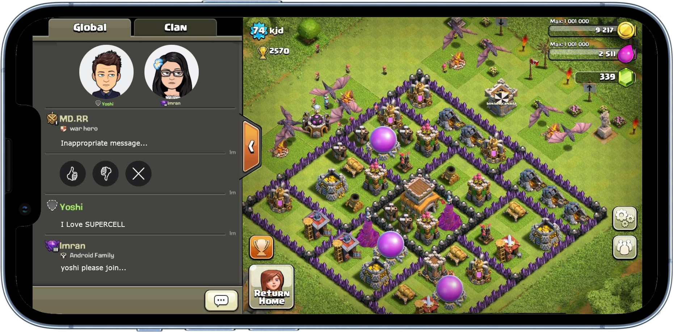
IN-GAME APPLICATION

Slide 14
TIMELINE
Q2 2022
Q3 2022
Q4 2022
2023
2024
Proof of concept and first Prototype.
Extensive studies and expanding target audience.
The smallest planet of them all.
Early adopters close support implementation.
Worldwide
Launch as SaaS.
1
2
3
4
5

Slide 15
OUR VISION
SOCIAL IMPACT
ONLINE SOCIAL LIFE
CURRENT SITUATION
Benefiting society with less toxicity. Users, Platforms - Everybody benfits.
Make new connections with no fear of being harrased, just like in real life.
Due to the way we had to communicate over the last 3 years, synthetic empathy is more important than ever.

Slide 16
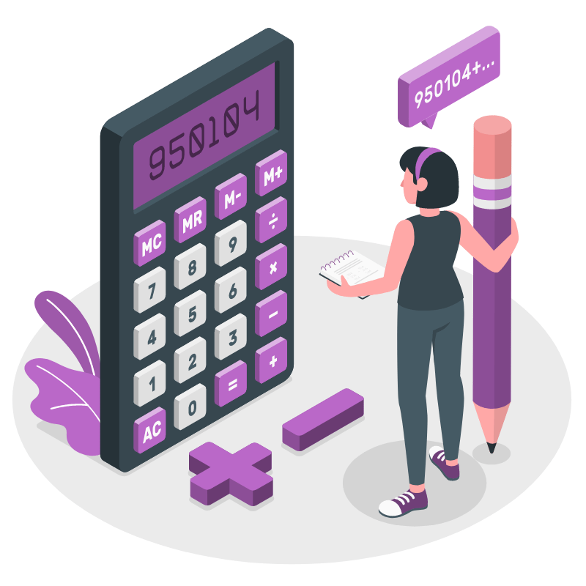
100,000,000
DAILY SUPERCELL USERS

Slide 17
4,900,000,000
POTENTIAL DAILY USERS

Slide 18
POSITIVE FEEDBACK LOOP
RESPOND
TIME
LAUNCH RESPONSE!
Responses are time sensitive.
ANALYSE
EVALUATE
Pair up correct response based on underlying Data.
Look back on hisotric data to

Slide 19
ChatGuard
YOUR HOLISTIC CHAT SOLUTION

